Slide 1
A Review of HCI Usability Standards and Assessment Tools
CS5760 – Spring, 2019
Anne Linja
Topic Assignment 3 - Presentation

Slide 2
"It's not what you know, but what you didn't know before you knew what you now know. Once you know, you'll never again know what it felt like not to know what you now know."

Slide 3
What is HCI Usability?
ISO 9241 definition:
The effectiveness, efficiency and satisfaction with which specified users achieve specified goals in particular environments. effectiveness: the accuracy and completeness with which specified users can achieve specified goals in particular environments.

Slide 4
What is HCI Usability?
The system should:
be easy, efficient, useful, and productive
have clear navigation and objective accomplishment
focus on all types of users and social contexts
the design should aid the human-computer interaction
have reduced maintenance and upgrade/update costs

Slide 5
What is HCI Usability?
The system should: (cont)
have usefulness, HCI compatibility, reliability, performance, manageability, practical acceptability
have few errors, and an easy, intuitive way to recover from any errors that are made
Users should be able to know where they are in a process and be able to move forward or backward as necessary to fit their tasks and level of expertise
be aesthetically pleasing

Slide 6
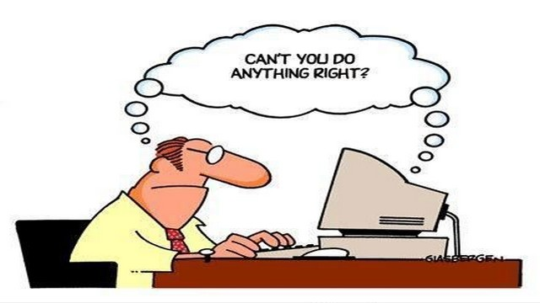
Why do we need to worry about HCI Usability?
IMAGE SIZE EXAMPLE

Slide 7
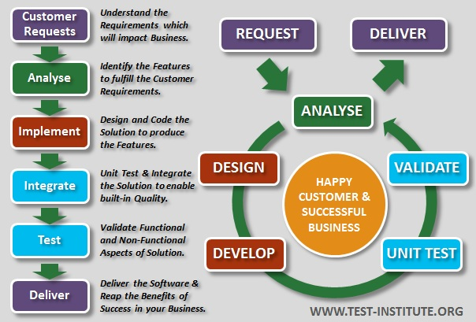

Why do we need to worry about HCI Usability?
How the designer sees the system:

Slide 8
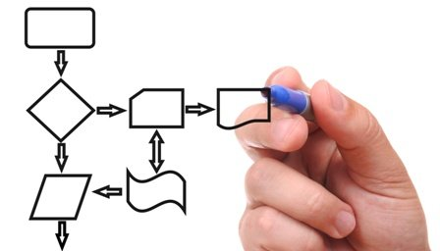
Why do we need to worry about HCI Usability?
How the end-user imagines the system will be:

Slide 9
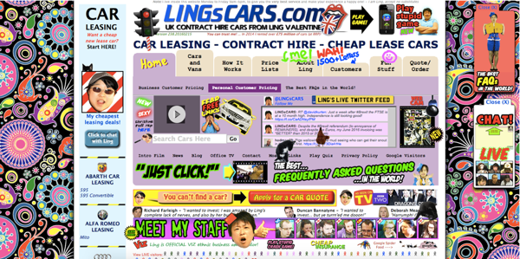
Why do we need to worry about HCI Usability?
How the user sees the system if their mental model doesn’t match the designer’s concept:

Slide 10
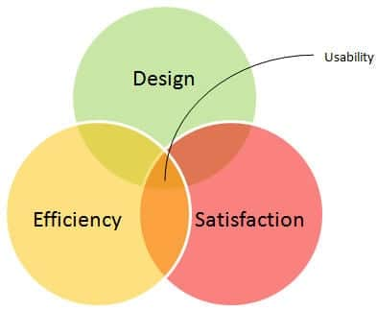
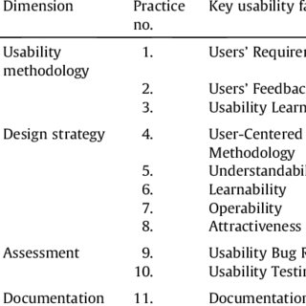
A Review of Assessment Tools, Designing Principles and Guidelines

Slide 11
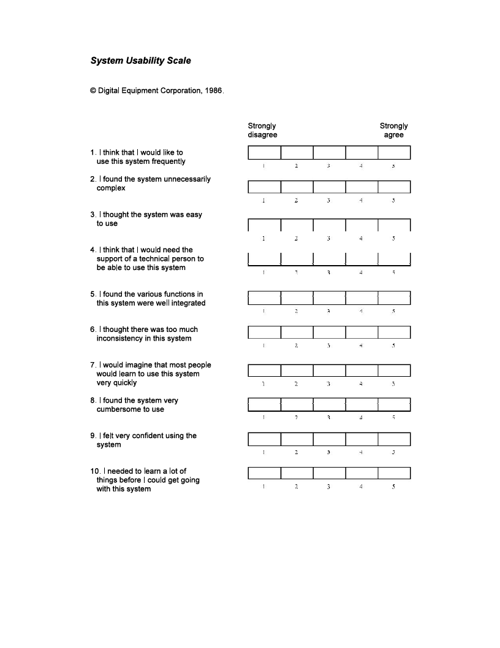
System Usability Scale
John Brooke
1986
10 item questionnaire with five response options for respondents; from Strongly disagree to Strongly agree
HALF PAGE IMAGE SIZE EXAMPLE
Notes:
1. It provides an at-a-glance snapshot of how usable or unusable your system is.
Single number score.
2. It's easy to use, at scale or with a small number of respondents.
8 raters yield 75% accuracy.
90% asymptote
administered in-person, via email, or across a variety of other media

Slide 12
Schneiderman’s Rules of Interface Design
01
Reduce short-term memory load - 08
01 - Strive for consistency
08
02
Support internal locus of control - 07
8 Golden Rules
02 - Cater to universal usability
07
03
Permit easy reversal of actions - 06
03 - Offer informative feedback
06
04
Prevent errors - 05
05
04 - Design dialogs to yield
Notes:
Apples integrates 8 Design Principles into their designing.
1. Strive for consistency.
Consistent sequences of actions should be required in similar situations; identical terminology should be used in prompts, menus, and help screens; and consistent color, layout, capitalization, fonts, and so on, should be employed throughout. Exceptions, such as required confirmation of the delete command or no echoing of passwords, should be comprehensible and limited in number
2. Seek universal usability.
Recognize the needs of diverse users and design for plasticity, facilitating transformation of content. Novice to expert differences, age ranges, disabilities, international variations, and technological diversity each enrich the spectrum of requirements that guides design. Adding features for novices, such as explanations, and features for experts, such as shortcuts and faster pacing, enriches the interface design and improves perceived quality.
3. Offer informative feedback.
For every user action, there should be an interface feedback. For frequent and minor actions, the response can be modest, whereas for infrequent and major actions, the response should be more substantial. Visual presentation of the objects of interest provides a convenient environment for showing changes explicitly (see the discussion of direct manipulation in Chapter 7).
4. Design dialogs to yield closure.
Sequences of actions should be organized into groups with a beginning, middle, and end. Informative feedback at the completion of a group of actions gives users the satisfaction of accomplishment, a sense of relief, a signal to drop contingency plans from their minds, and an indicator to prepare for the next group of actions. For example, e-commerce websites move users from selecting products to the checkout, ending with a clear confirmation page that completes the transaction.
5. Prevent errors.
As much as possible, design the interface so that users cannot make serious errors; for example, gray out menu items that are not appropriate and do not allow alphabetic characters in numeric entry fields (Section 3.3.5). If users make an error, the interface should offer simple, constructive, and specific instructions for recovery. For example, users should not have to retype an entire name-address form if they enter an invalid zip code but rather should be guided to repair only the faulty part. Erroneous actions should leave the interface state unchanged, or the interface should give instructions about restoring the state.
6. Permit easy reversal of actions.
As much as possible, actions should be reversible. This feature relieves anxiety, since users know that errors can be undone, and encourages exploration of unfamiliar options. The units of reversibility may be a single action, a data-entry task, or a complete group of actions, such as entry of a name-address block.
7. Keep users in control.
Experienced users strongly desire the sense that they are in charge of the interface and that the interface responds to their actions. They don’t want surprises or changes in familiar behavior, and they are annoyed by tedious data-entry sequences, difficulty in obtaining necessary information, and inability to produce their desired result.
8. Reduce short-term memory load.
Humans’ limited capacity for information processing in short-term memory (the rule of thumb is that people can remember “seven plus or minus two chunks” of information) requires that designers avoid interfaces in which users must remember information from one display and then use that information on another display. It means that cellphones should not require reentry of phone numbers, website locations should remain visible, and lengthy forms should be compacted to fit a single display.

Slide 13
Summary and excerpts from Schneiderman's Guidelines, Principles, and Theories (1987)
Task Sequences
ID
Team
Boat
Location
Station
Lat/Long
Weather
Wind
Sea State
Etc
Etc
Etc
1
Notes:
Guidelines
Can be used for a variety of systems

Slide 14
Summary and excerpts from Schneiderman's Guidelines, Principles, and Theories
ID
Team
Boat
Location
Station
Lat/Long
Weather
Wind
Sea State
Etc
Etc
Etc
1
Descriptive Links
2
Save and Continue
Continue

Slide 15
Summary and excerpts from Schneiderman's Guidelines, Principles, and Theories
ID
Team
Boat
Location
Station
Lat/Long
Weather
Wind
Sea State
Etc
Etc
Etc
2
Save and Continue
Continue
1
Descriptive Heading
Utilities
Import GPS Long/Lat
Import Weather Data
Extras
Import GPS Long/Lat
Import
Import GPS Long/Lat
Import Weather Data
Import Weather Data
3

Slide 16



Summary and excerpts from Schneiderman's Guidelines, Principles, and Theories
Use checkboxes for binary choices
Do you want to continue? Yes or no?
4

Slide 17
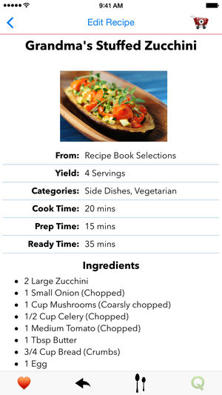
Summary and excerpts from Schneiderman's Guidelines, Principles, and Theories
4
Do you want to continue? Yes or no?
Develop pages that will print properly
5

Slide 18

Summary and excerpts from Schneiderman's Guidelines, Principles, and Theories
4
5
Do you want to continue? Yes or no?
Use thumbnail images to preview larger images
6

Slide 19
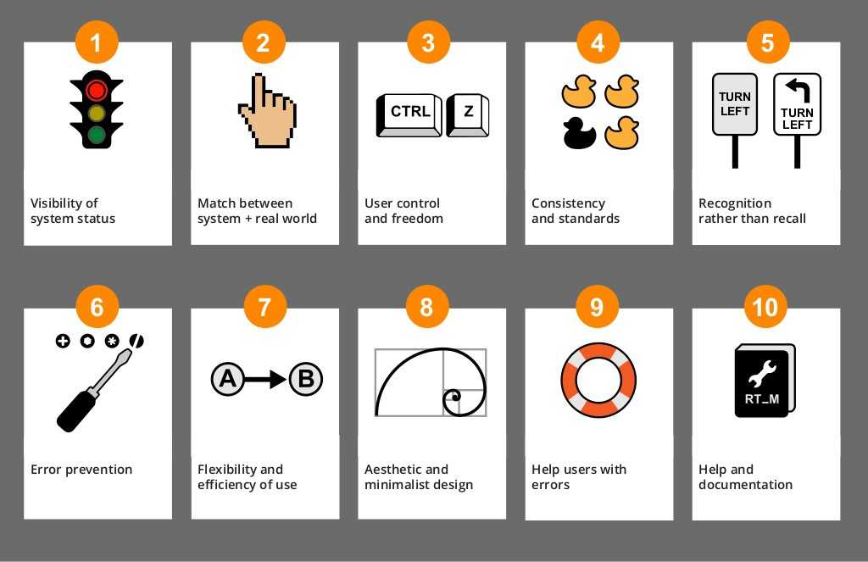
Nielsen’s Heuristics, 1990
Notes:
Most widely used
With all the bells and whistles available to web designers this simple list brings it back to the user and usability

Slide 20
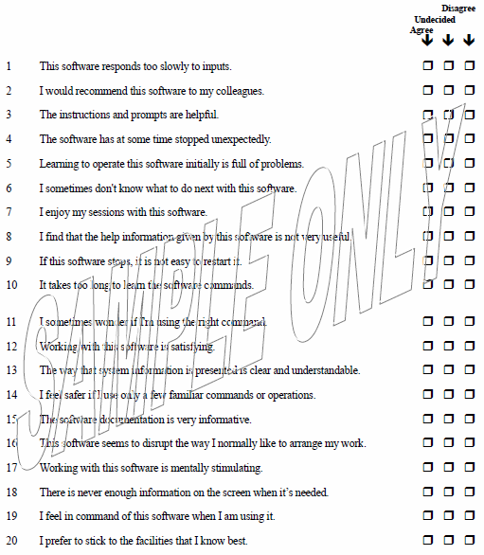
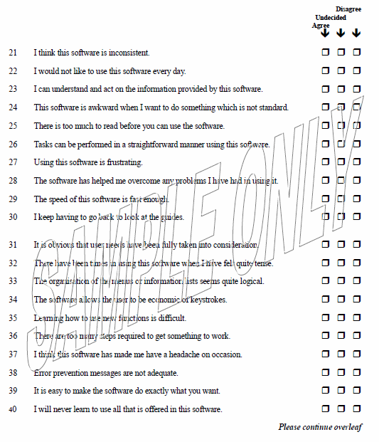
Software Usability Measurement Inventory (Human Factors Research Group, Ireland, 1993)
Draws on the definition in ISO 9241 (covering ergonomics 50-item questionnaire devised in accordance with psychometric practice)
Notes:
From user’s viewpoint
if an assessor marks "Undecided" to statement 19, "I feel in command of this software when I am using it", the developer is made aware that there's something missing, or something added, that's making the assessor unsure of their command with the software. The assessor is not communicating exactly what it is, but that the feeling of being in command is not quite there and not quite missing.

Slide 21
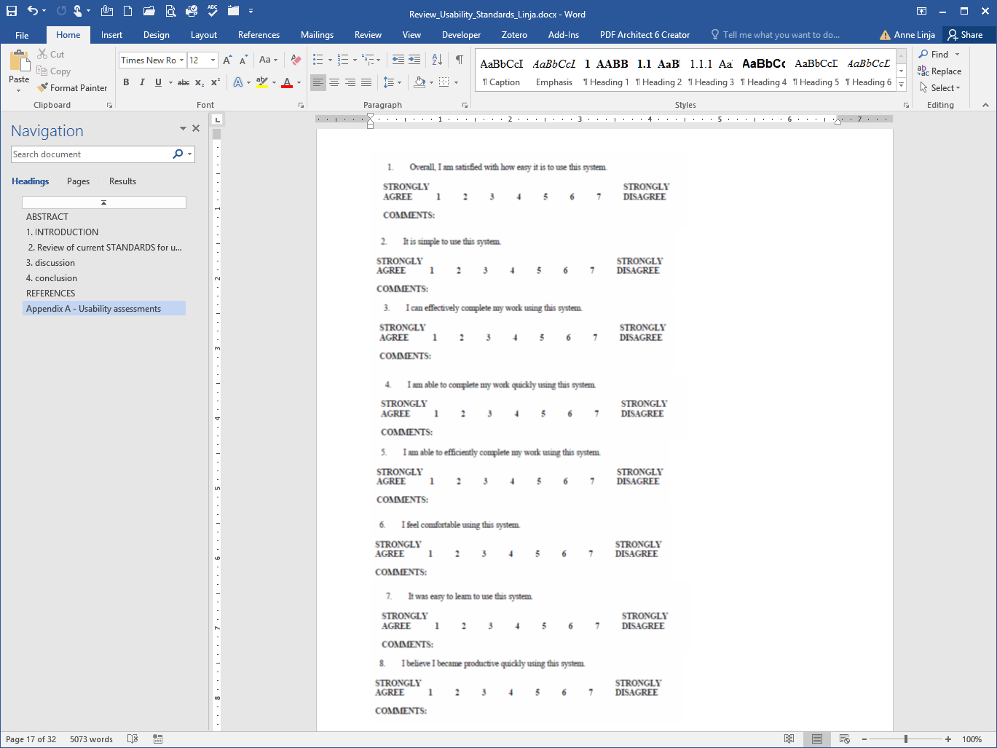
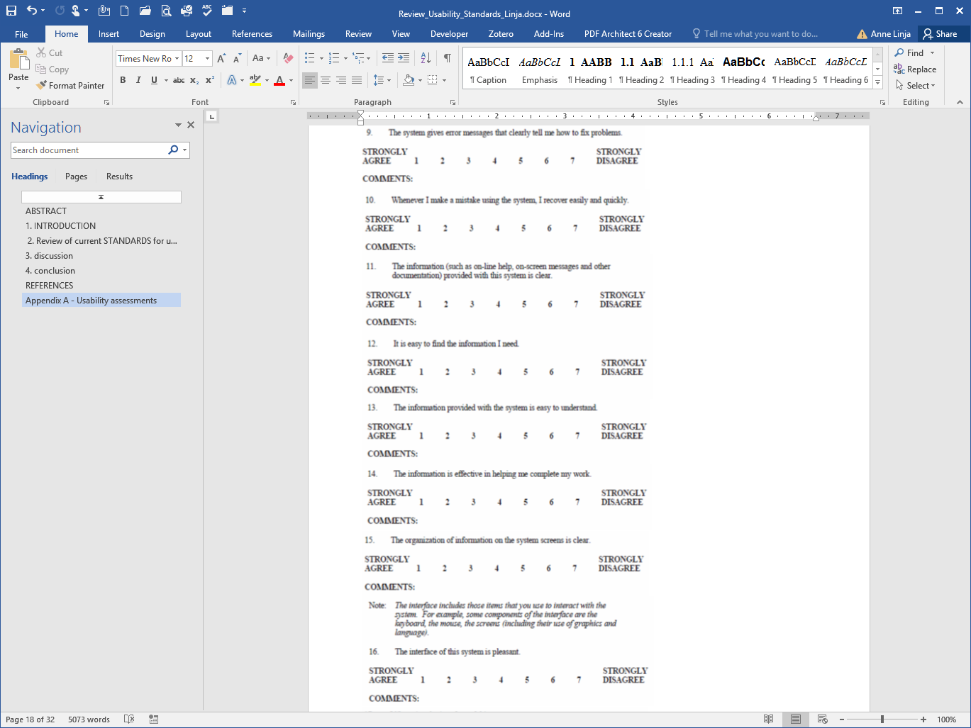
Computer System Usability Questionnaire (Lewis, for IBM 1995)
19 item questionnaire with 7 response options from Strongly Disagree to Strongly Agree
Notes:
An important aspect of this question is the fact that it requires the evaluator to allow themselves to make mistakes. From a cognitive aspect, recovering and learning from our mistakes can be a more memorable event than simply stumbling across a feature and not remembering where it was the next time you're looking for it.
Workplace systems: Looks at task at hand and user’s ability to complete it quickly -- productivity

Slide 22

Gerhardt’s 10 Cognitive Engineering principles for enhancing HCI, 1996
Notes:
limited displays to the data necessary at each given moment
timely data
Principle 1. Automate unwanted workload.
Eliminate mental calculations, estimations, comparisons, and any unnecessary thinking, to free cognitive resources for high-level tasks.

Slide 23

Gerhardt’s 10 Cognitive Engineering principles for enhancing HCI, 1996
Notes:
Principle 2. Reduce uncertainty.
Display data in a manner that is clear and obvious to reduce decision time and error.

Slide 24
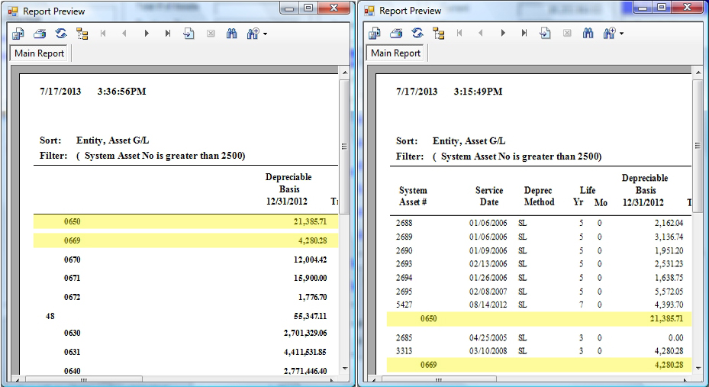
Gerhardt’s 10 Cognitive Engineering principles for enhancing HCI, 1996
Notes:
Principle 3. Fuse data.
Bring together lower level data into a higher level summation to reduce cognitive load.
Principle 4. Present new information with meaningful aids to interpretation.
New information should be presented within familiar frameworks (e.g., schemas, metaphors, everyday terms) so that information is easier to absorb.
Principle 5. Use names that are conceptually related to function.
Display names and labels should be context-dependent, which will improve recall and recognition.
Principle 6. Group data in consistently, meaningful ways.
Within a screen, data should be logically grouped; across screens, it should be consistently grouped. This will decrease information search time.
Principle 7. Limit data driven tasks.
Use color and graphics, for example, to reduce the time spent assimilating raw data.
Principle 8. Include in the displays only that information needed by the operator at a given time.
Exclude extraneous information that is not relevant to current tasks so that the user can focus attention on critical data.
Principle 9. Provide multiple coding of data.
The system should provide data in varying formats and/or levels of detail in order to promote cognitive flexibility and satisfy user preferences.
Principle 10. Practice judicious redundancy.
Principle 10 was devised by the first two authors to resolve the possible conflict between Principles 6 and 8, that is, in order to be consistent, it is sometimes necessary to include more information than may be needed at a given time.

Slide 25
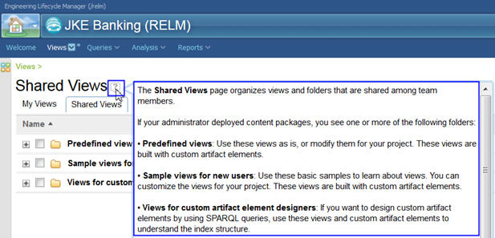
Gerhardt’s 10 Cognitive Engineering principles for enhancing HCI, 1996
Notes:
Principle 4. Present new information with meaningful aids to interpretation.
New information should be presented within familiar frameworks (e.g., schemas, metaphors, everyday terms) so that information is easier to absorb.

Slide 26

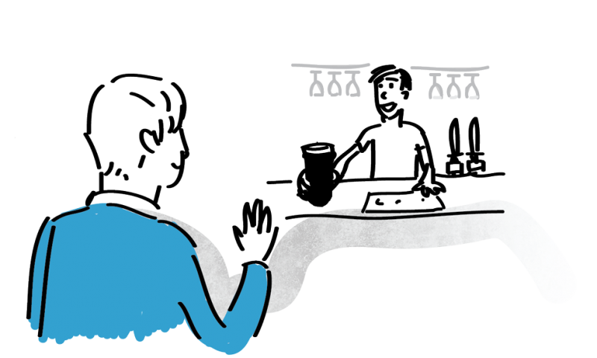

Gerhardt’s 10 Cognitive Engineering principles for enhancing HCI, 1996
Notes:
Principle 5. Use names that are conceptually related to function.
Display names and labels should be context-dependent, which will improve recall and recognition.
Principle 6. Group data in consistently, meaningful ways.
Within a screen, data should be logically grouped; across screens, it should be consistently grouped. This will decrease information search time.
Principle 7. Limit data driven tasks.
Use color and graphics, for example, to reduce the time spent assimilating raw data.
Principle 8. Include in the displays only that information needed by the operator at a given time.
Exclude extraneous information that is not relevant to current tasks so that the user can focus attention on critical data.
Principle 9. Provide multiple coding of data.
The system should provide data in varying formats and/or levels of detail in order to promote cognitive flexibility and satisfy user preferences.
Principle 10. Practice judicious redundancy.
Principle 10 was devised by the first two authors to resolve the possible conflict between Principles 6 and 8, that is, in order to be consistent, it is sometimes necessary to include more information than may be needed at a given time.

Slide 27

Gerhardt’s 10 Cognitive Engineering principles for enhancing HCI, 1996
Notes:
Principle 6. Group data in consistently, meaningful ways.
Within a screen, data should be logically grouped; across screens, it should be consistently grouped. This will decrease information search time.
Principle 7. Limit data driven tasks.
Use color and graphics, for example, to reduce the time spent assimilating raw data.
Principle 8. Include in the displays only that information needed by the operator at a given time.
Exclude extraneous information that is not relevant to current tasks so that the user can focus attention on critical data.
Principle 9. Provide multiple coding of data.
The system should provide data in varying formats and/or levels of detail in order to promote cognitive flexibility and satisfy user preferences.
Principle 10. Practice judicious redundancy.
Principle 10 was devised by the first two authors to resolve the possible conflict between Principles 6 and 8, that is, in order to be consistent, it is sometimes necessary to include more information than may be needed at a given time.

Slide 28
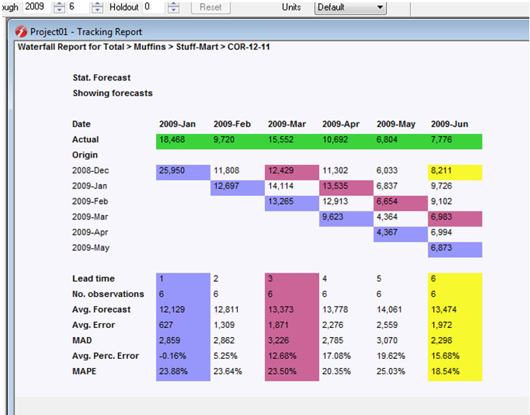
Gerhardt’s 10 Cognitive Engineering principles for enhancing HCI, 1996
Notes:
Principle 7. Limit data driven tasks.
Use color and graphics, for example, to reduce the time spent assimilating raw data.
Principle 8. Include in the displays only that information needed by the operator at a given time.
Exclude extraneous information that is not relevant to current tasks so that the user can focus attention on critical data.
Principle 9. Provide multiple coding of data.
The system should provide data in varying formats and/or levels of detail in order to promote cognitive flexibility and satisfy user preferences.
Principle 10. Practice judicious redundancy.
Principle 10 was devised by the first two authors to resolve the possible conflict between Principles 6 and 8, that is, in order to be consistent, it is sometimes necessary to include more information than may be needed at a given time.

Slide 29
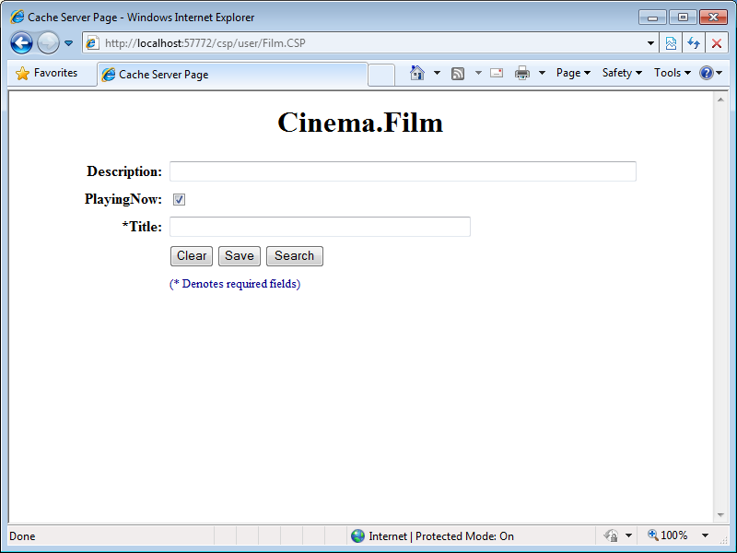
Gerhardt’s 10 Cognitive Engineering principles for enhancing HCI, 1996
Notes:
Principle 8. Include in the displays only that information needed by the operator at a given time.
Exclude extraneous information that is not relevant to current tasks so that the user can focus attention on critical data.

Slide 30
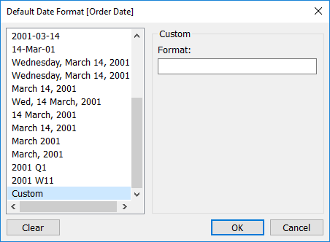
Gerhardt’s 10 Cognitive Engineering principles for enhancing HCI, 1996
Notes:
Principle 9. Provide multiple coding of data.
The system should provide data in varying formats and/or levels of detail in order to promote cognitive flexibility and satisfy user preferences.

Slide 31
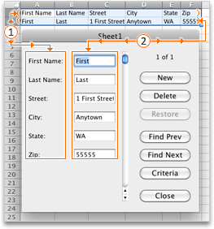
Gerhardt’s 10 Cognitive Engineering principles for enhancing HCI, 1996
Notes:
Principle 10. Practice judicious redundancy.
Principle 10 was devised by the first two authors to resolve the possible conflict between Principles 6 and 8, that is, in order to be consistent, it is sometimes necessary to include more information than may be needed at a given time.

Slide 32

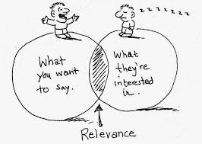
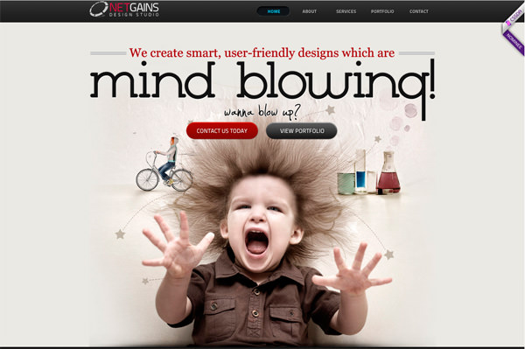
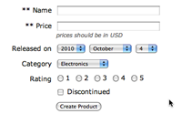

MSDN Usability Research Guidelines (1997)
Research findings that can provide ideas to increase the usability and appeal of websites
Notes:
stating that systems can contain a variety of stimuli to garner responses from website visitors using rapid motions, changes in visual field, and novel objects.
Surprise and engage the visitor with an object first, and they will spend time trying to make sense of it and decide its relevance to their goals.
If the goal is relevant, the website might be rated as more usable or satisfying.
Although the considerations offered by Microsoft can be used to assess websites, it should be noted that the purpose of engaging visitors to their websites is for commercial reasons and one should be careful to extract true usability questions from the text

Slide 33
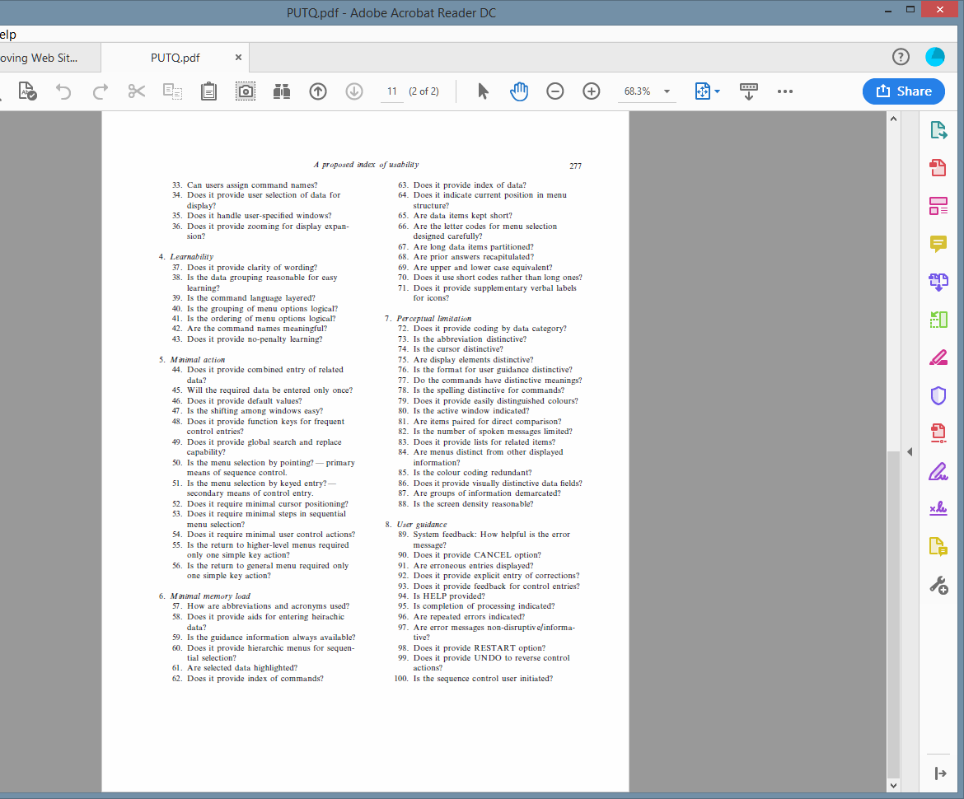
Purdue Usability Testing Questionnaire, Lin, Choong, Salvendy, 1997
Notes:
Can also be used to compare user performance
asks if related items are listed.
Lists make it easy to see
1 the items are related,
2 there may be some sort of priority or hierarchy,
3 the user may be able to drill into any item for more information, and
4 the user sees a clearly established group, visually intuitive.

Slide 34
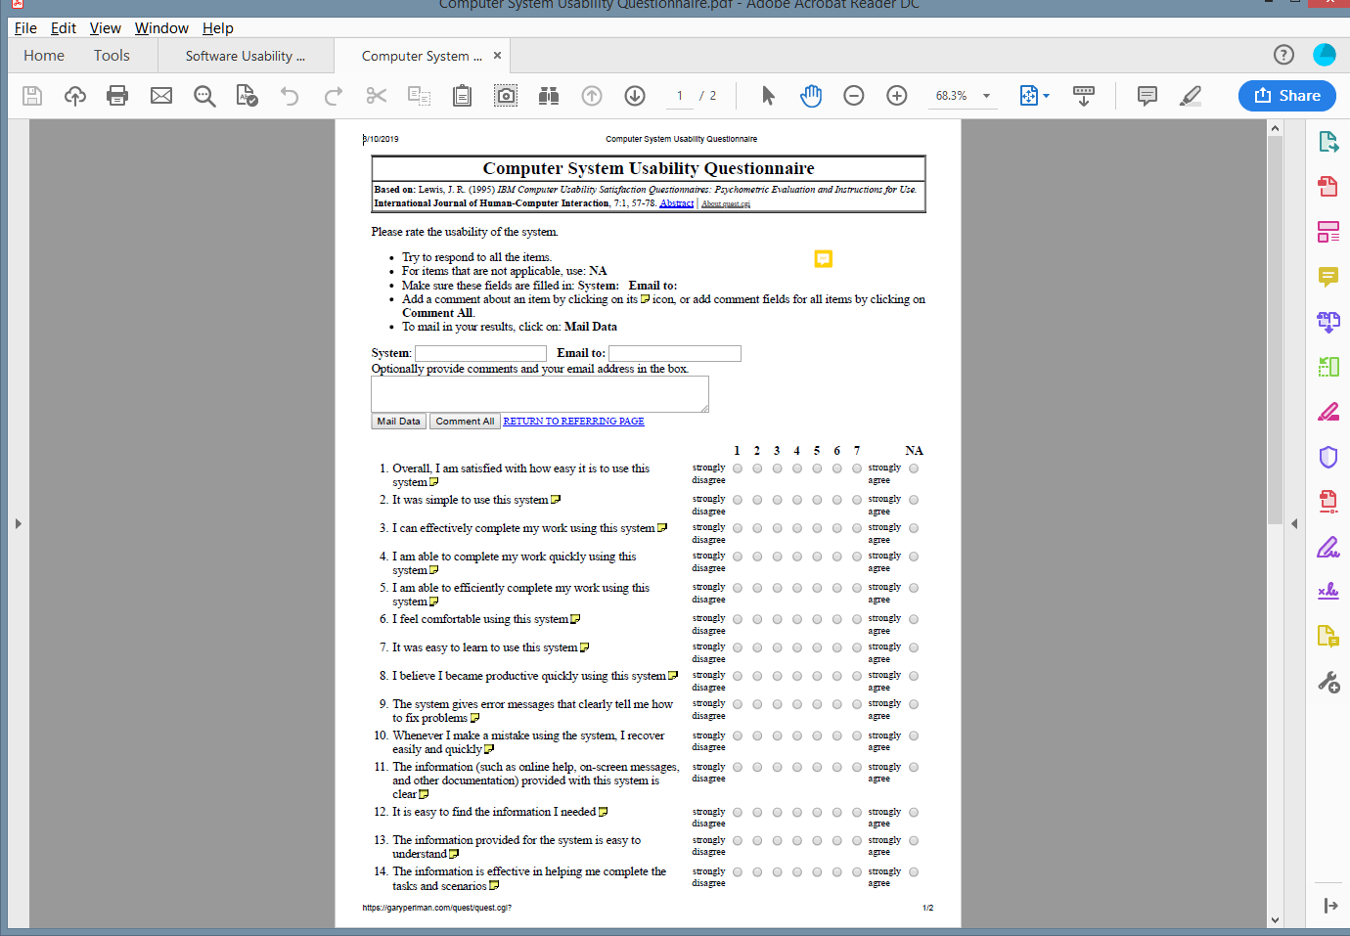
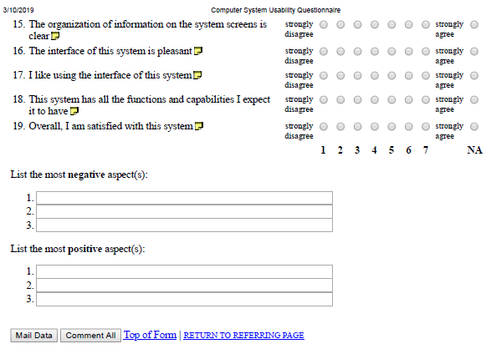
Perlman, 1998
Based on V1, with added questions asking for comments, 3 most negative aspects and 3 more positive aspects
Notes:
Adds 3 negative and 3 positive aspects (short answer)

Slide 35
Interface Consistency Testing Questionnaire
Ozok and Salvendy
94-question evaluator of consistency levels of web-based interfaces
2001
Notes:
geared towards grammar, punctuation and layouts;
does consider the context and consistency amongst the words used, the sentence structure, and "look and feel" of the the GUI placement (i.e. buttons, combo boxes, etc.)
This would be great if assessing the usability of a site that is mostly readable text, for example, a magazine website, or an instructional system.

Slide 36
keepitusable.com, 2011
Notes:
important assessments of this tool that might not be applicable to a website or system viewable on a larger monitor are:
- minimalist design, non-ambiguous icons, and assurance that the user's finger is not obscuring critical feedback.
There is so much less screen real estate on mobile apps

Slide 37
Website Analysis Measurement and Inventory
Kirakowski & Claridge
Website analysis service for measuring user experience and assessing delivery of business goals online
2016
Notes:
"I feel efficient when I'm using this website", isn't looking at feature placement, but rather, how the user is feeling.
.
Desmet & Hekkert (2007) "saw that experience influences behaviour and that behaviour influences the experience".
A pleasant experience will result in the user wanting to repeatedly use the system being assessed.

Slide 38
StayInTech UX Chesklist
2018
Notes:
grouping items into descriptive, related groups".
It's intuitive to sort data that transcends time by years, data that has categories by category, etc.
Also, they stress the important of personalizing regional information (language, currency, date format, etc.).

Slide 39

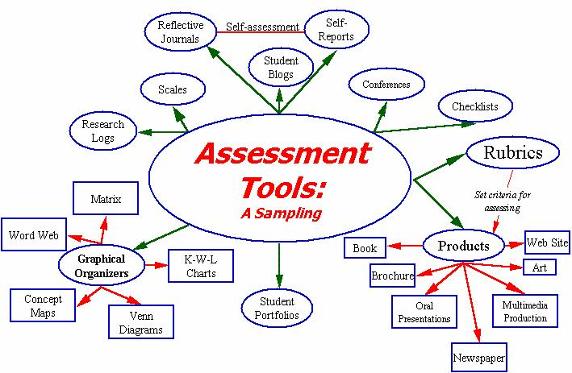

Slide 40
REFERENCES
Brooke, J. (1996). SUS-A quick and dirty usability scale. Usability evaluation in industry, 189(194), 4-7.
Claridge, N., & Kirakowski, J. (2011). WAMMI: website analysis and measurement inventory questionnaire. Retrived May, 20, 2013.
Desmet, P. M., & Hekkert, P. (2007). Framework of product experience. International journal of design, 1(1), 57-66.
Galitz, Wilbert O. User-Interface Screen Design. Boston: QED Publishing Group, 1993
Gerhardt‐Powals, J. (1996). Cognitive engineering principles for enhancing human‐computer performance. International Journal of Human‐Computer Interaction, 8(2), 189-211.
Keeker, K. (1997). Improving web site usability and appeal. Retrieved July 24, 1997.
Kirakowski, J., & Corbett, M. (1993). SUMI: The software usability measurement inventory. British journal of educational technology, 24(3), 210-212.
Lewis, J. R. (1995). IBM computer usability satisfaction questionnaires: psychometric evaluation and instructions for use. International Journal of Human‐Computer Interaction, 7(1), 57-78.
Lin, H. X., Choong, Y. Y., & Salvendy, G. (1997). A proposed index of usability: a method for comparing the relative usability of different software systems. Behaviour & information technology, 16(4-5), 267-277.

Slide 41
REFERENCES (cont)
Moser, J. S., Schroder, H. S., Heeter, C., Moran, T. P., & Lee, Y. H. (2011). Mind your errors: Evidence for a neural mechanism linking growth mind-set to adaptive posterror adjustments. Psychological Science, 22(12), 1484-1489.
Nielsen, J. (1995). 10 usability heuristics for user interface design. Nielsen Norman Group, 1(1).
Nielson (https://www.nngroup.com/articles/ten-usability-heuristics/)
Ozok, A. A., & Salvendy, G. (2001). How consistent is your web design?. Behaviour & Information Technology, 20(6), 433-447.
Perlman, G. (1998). Web-based user interface evaluation with questionnaires. Retrieved on, 3(22), 06.
Shneiderman, B., & Plaisant, C. Designing the User Interface: Strategies for Effective Human-Computer Interaction.
Smith, S. L., & Mosier, J. N. (1986). Guidelines for designing user interface software (No. MTR-10090). Bedford, MA: Mitre Corporation.
Tullis, T. S., & Stetson, J. N. (2004, June). A comparison of questionnaires for assessing website usability. In Usability professional association conference (Vol. 1).
Wickens, C. D., Hollands, J. G., Banbury, S., & Parasuraman, R. (2000). Engineering psychology & human performance. Prentice-Hall, Englewood Cliffs, NJ.

